Slide 1
Intelligent Customer Help Desk with Smart Document Understanding
NMAM Institute of Technology,Nitte
Under the Guidance of: Presented to:
Mr. Jayaprakash. Ch Mr. Sandeep Kumar Hegde
Program Manager Assistant Professor Gd. II
SmartBridge Educational Dept. of CSE
Services Pvt. Ltd
Presented by:
Jasmine Glani Mathias
(4NM17CS070)
8 Sem CSE B section

Slide 2
Introduction
For businesses, it has become necessary to solve the queries and problems of the customers.
Live agents can handle only one conversation at a time.
We also need artificial support system which works 24x7 satisfying customer queries.

Slide 3
About Company
SmartBridge is an EdTech organization with a vision to bridge the gap between academia & industry.
It provides outcome-based experiential learning programs on emerging technologies.
SmartBridge is in mission to build technology communities in academia to encourage students towards innovation & entrepreneurship.

Slide 4
Problem Formulation
To improve the need large customer support team 24x7.
The typical customer care chatbot can answer simple questions, such as store locations and hours, directions, and maybe even making appointments.
When a question falls outside of the scope, tell the customer the question isn’t valid or offer to speak to a real person.

Slide 5
Problem Formulation
Smart Document Understanding feature of Watson Discovery to train it on what text in the owner’s manual is important and what is not.
Develop chatbot which efficiently answers query of customer with its smart document understanding ability and guide toward the solution of the problem.

Slide 6
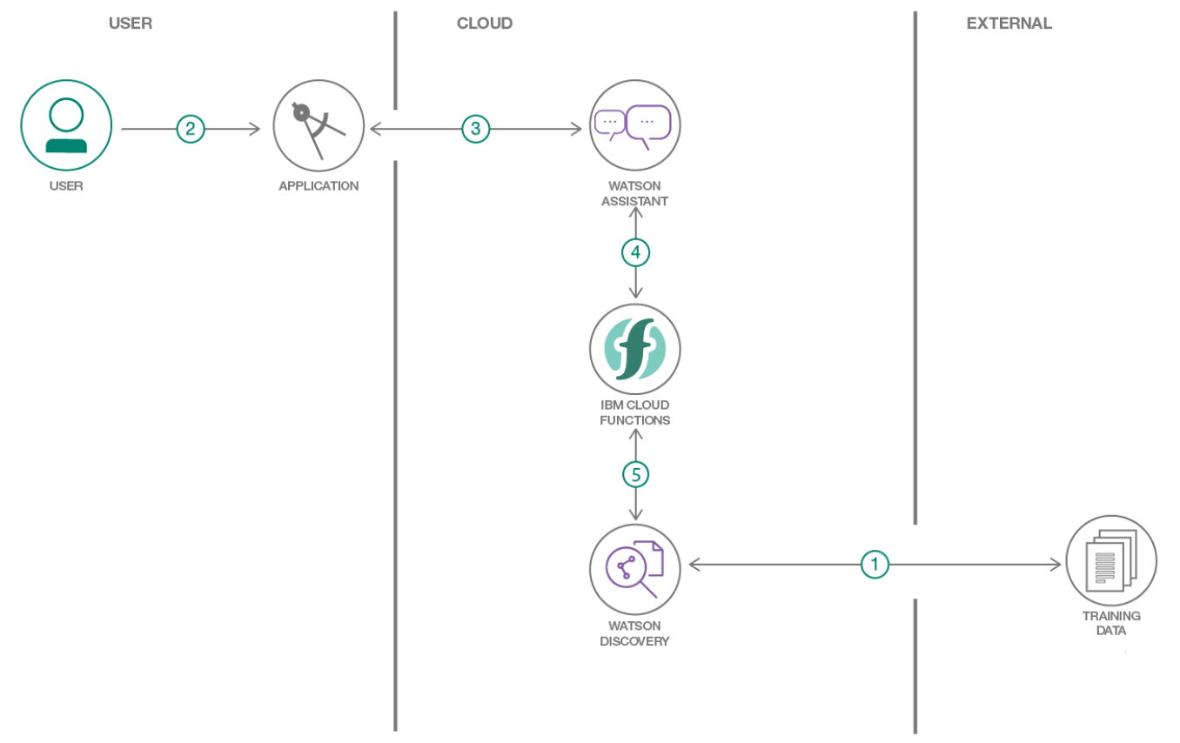
Proposed Architecture

Slide 7
Methodology
Create IBM Cloud services.
Watson Discovery
Watson Assistant
Node Red
Configure Watson Discovery.
Import the document.
Annotate with SDU.

Slide 8
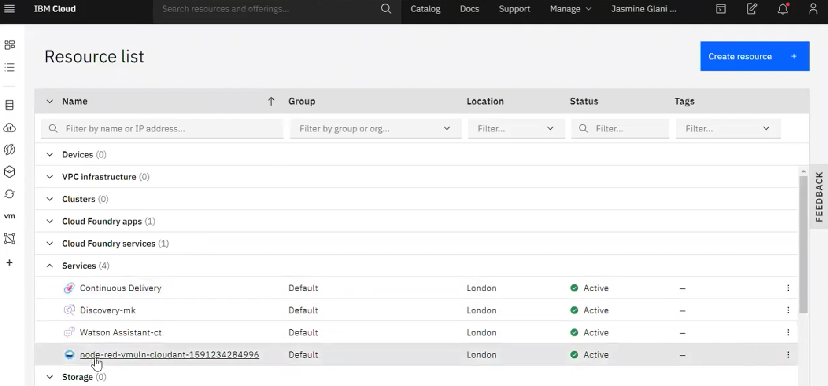
Methodology
Figure 1: IBM Cloud Services

Slide 9
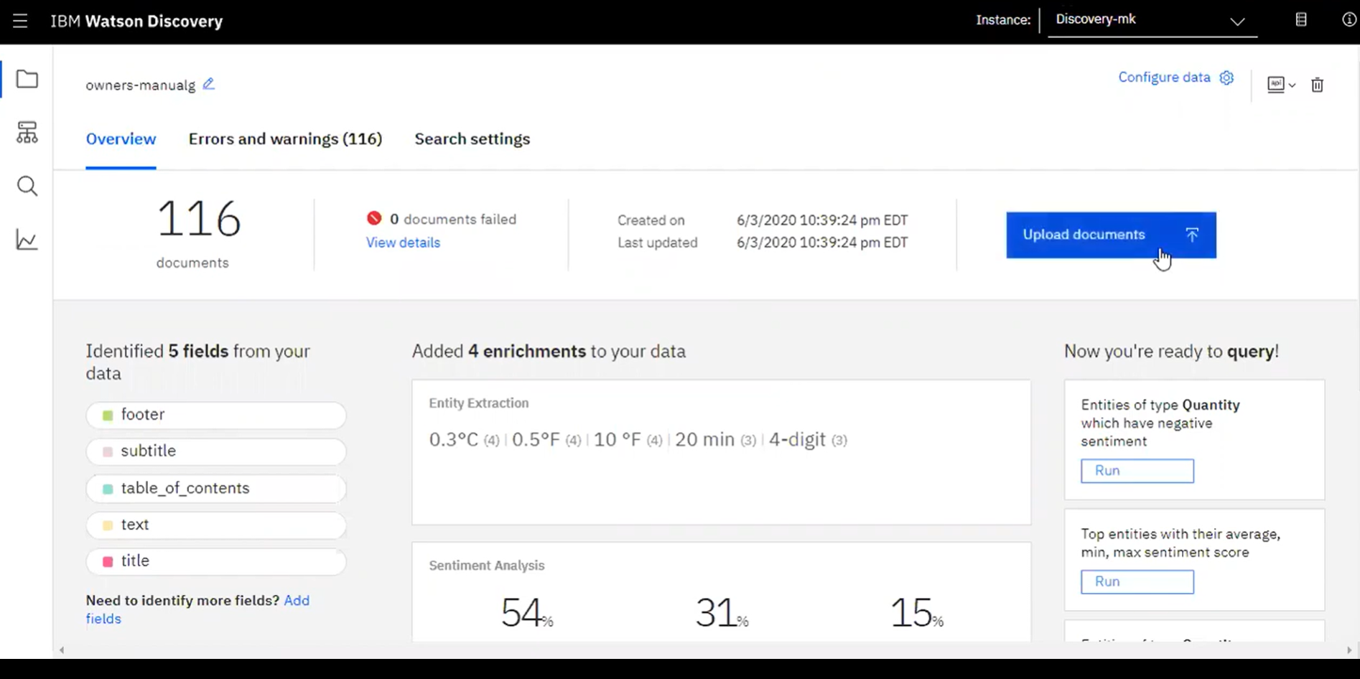
Methodology
Figure 2: IBM Watson Discovery

Slide 10
Methodology
Create IBM Cloud Functions action.
Configure Watson Assistant.
Add new intent
Create new dialog node
Enable webhook from Assistant
Create a Node-RED flow to connect all the services together, deploy and run Node-RED app.

Slide 11
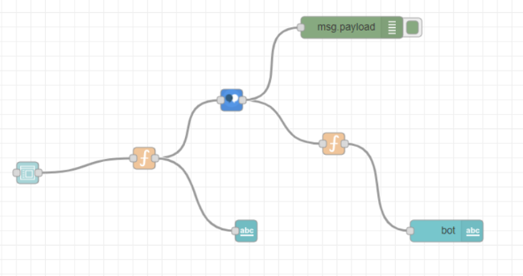
Methodology
Figure 3: Node Red Flow

Slide 12
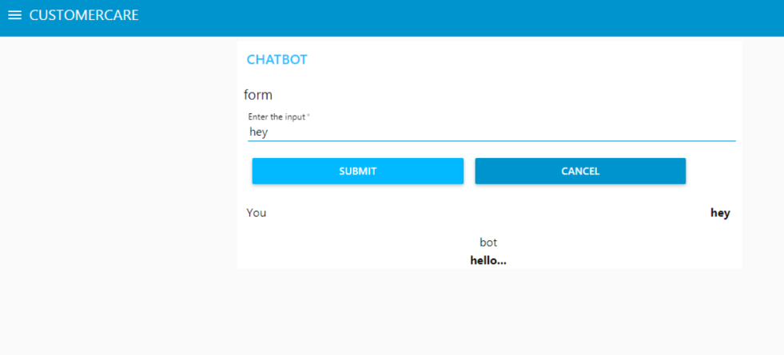
Results
Figure 4: Customer Care Chatbot(Greeting)

Slide 13
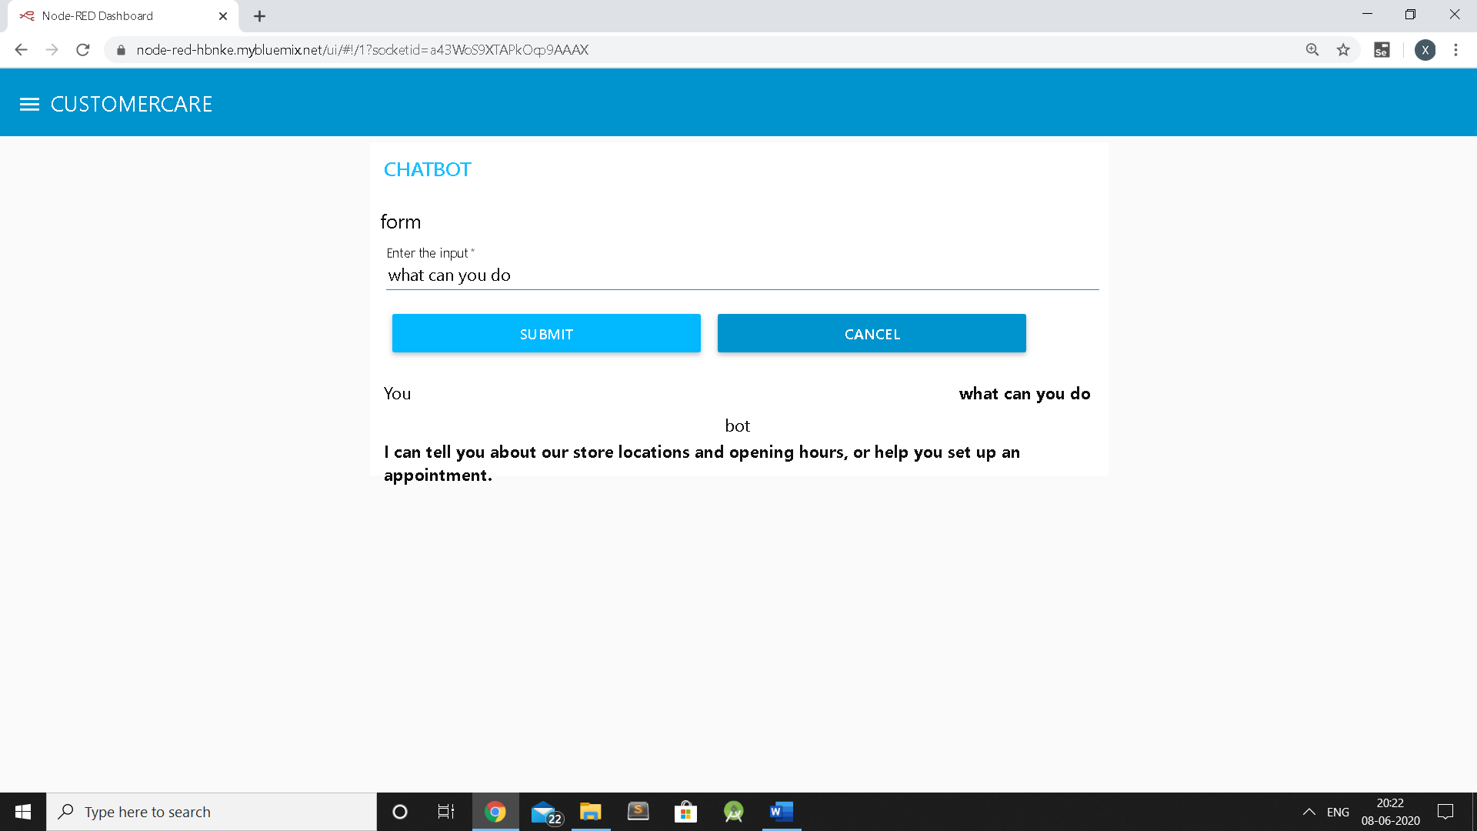
Results
Figure 5: Customer Care Chatbot(What can you do)

Slide 14
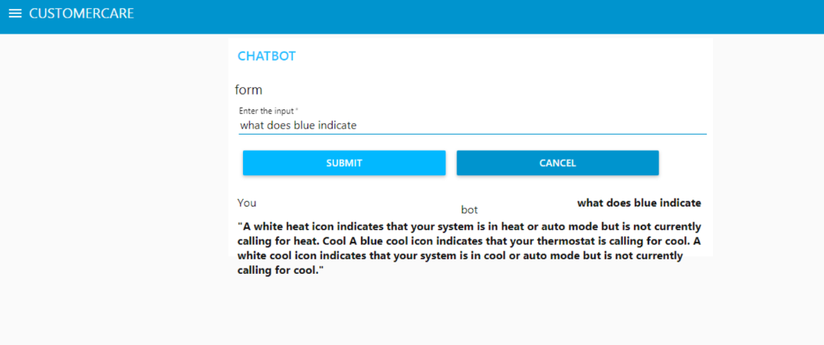
Results
Figure 6: Customer Care Chatbot
(What does blue indicate-Operation of device)

Slide 15
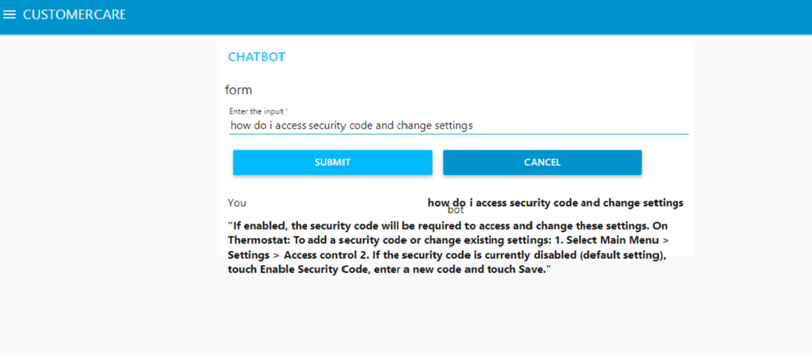
Results
Figure 7: Customer Care Chatbot(Operation of a device)

Slide 16
Future work to be implemented
Develop various other Watson services speech to text and text to speech can be integrated with chatbot.
Make chatbot hands free i.e using only voice for querying.

Slide 17
Conclusion
Chatbots are quickly making transformational changes and allowing businesses to thrive through customer interactions.
AI chatbots only means better engagement and relentless need for customer satisfaction.
It can efficiently guide the customers toward the solution
of the problem.

Slide 18
References
https://developer.ibm.com/tutorials/how-to-create-a-node-red-starter-application/
https://developer.ibm.com/components/watson-assistant/
https://developer.ibm.com/articles/introduction- watson-discovery/
https://www.ibm.com/watson/how-to-build-a-chatbot
https://www.ecobee.com/wpcontent/uploads/2014/09/ecobee3_UserGuide1.pdf
https://www.thesmartbridge.com/

Slide 19
THANK YOU

